Slide 1
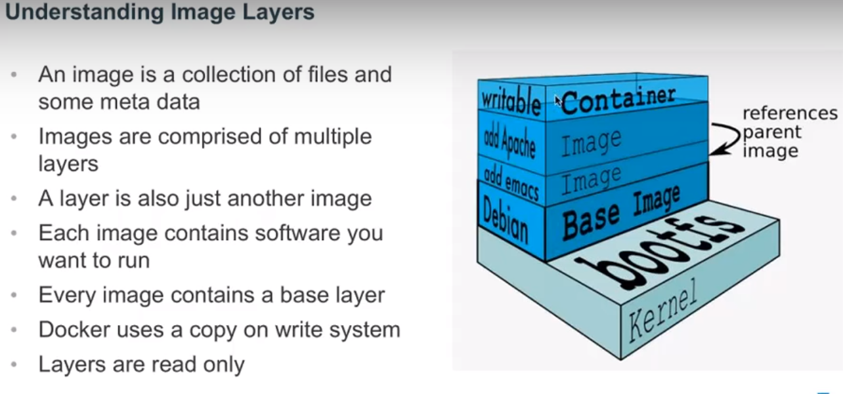
DOCKER
From docker.com

Slide 2
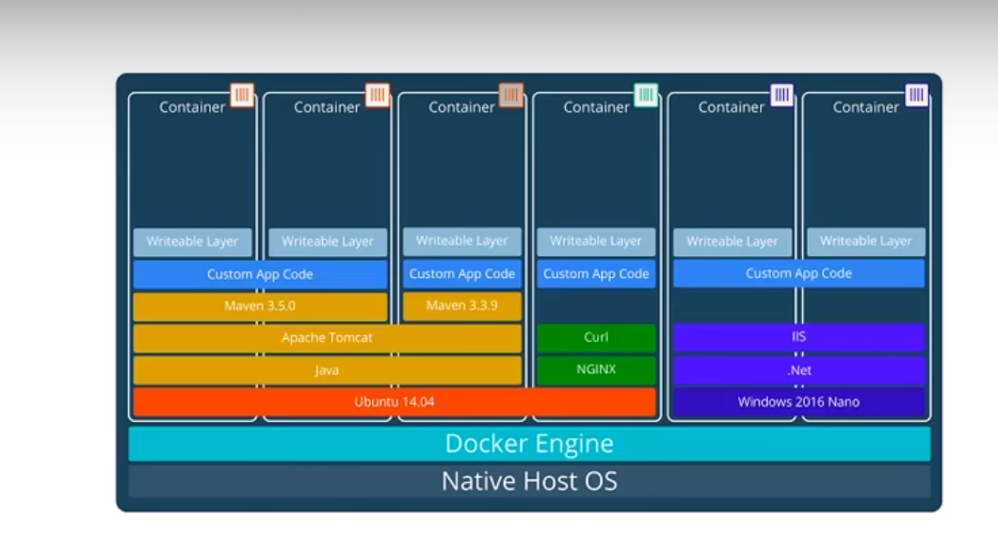
layers
From docker.com

Slide 3
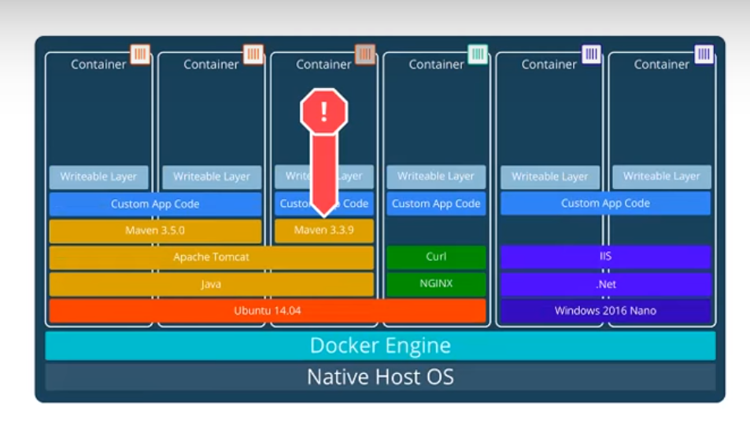
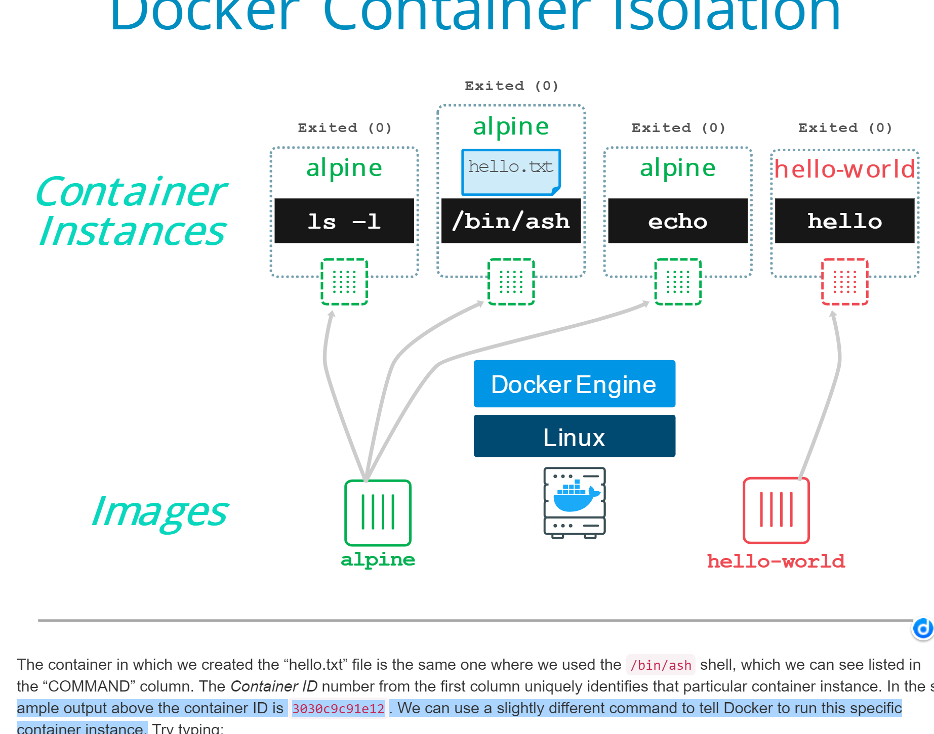
Isolation
Sperate file systems
Both from docker.com

Slide 4
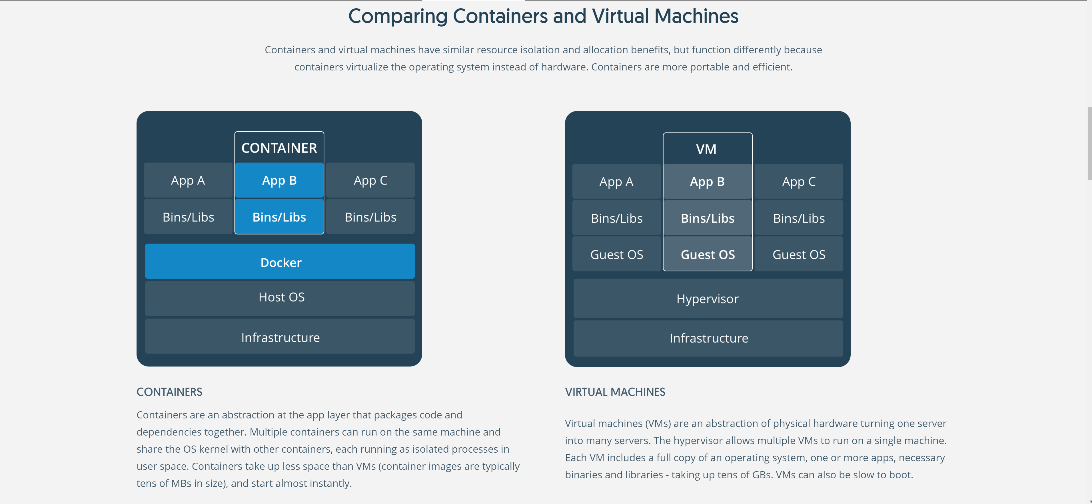
Abstraction at the app layer
Containers sharing the same OS
Abstraction of physical hardware,
one server into many servers.
A full copy of OS, mamy apps for each.

Slide 5
benefits
Developing environment for Multiple APPS, taking less space than VM
Easy to for new people to get on board , no more ”working on my machine”
One down, others not affected
Secure and easy to manage

Slide 6
Functions and Computation
In Mathematica, everything is a function.
Is everything a function?
Correspondence between a collection of possible input values and a collection of output values so that each possible input is assigned a unique output.
Computable and uncomputable.

Slide 7
A Noncomputable Function
The halting problem.
Self-reference

Slide 8
some interesting questions...
We use high level language to write the assembler-quite common now,but,how is the first assembler created?
if we follow the staging process ,we should write it in machine code...without utilities to deal with strings
HOW TO DO THAT?

Slide 9
Bootstrapping
It's a kind of technique to write compilers(also true for assemblers,just more complicated)
you can produce a self-compile compiler, that is, compiler (or assembler) written in the source programming language that it intends to compile. An initial core version of the compiler - the bootstrap compiler - is generated in a different language (which could be assembly language); successive expanded versions of the compiler are developed using this minimal subset of the language.

Slide 10
chicken and egg?
how many ways can we write a compiler?
You can write it in another language--and compile it using according compiler.
OR
The compiler is cross compiled from another architecture where there already exists a compiler; this is how compilers for C are usually ported to other platforms.
OR
Writing the compiler in the language you want; then hand-compiling it from source (most likely in a non-optimized way)

